Slide 1

Healthier Buildings, Healthier People
Indoor Environments Division

Slide 2
Federal Radon Action Plan
The Federal Commitment to Save Lives
Progress to Date
Moving Forward

Slide 3
The Federal Commitment to Saving Lives

Slide 4
Radon: A Serious Public Health Threat
2nd leading cause of lung cancer, leading cause among non-smokers
20,000 annual lung cancer deaths
We know how to fix it and prevent it – 2.7M homes
But not nearly enough progress - 8 million homes remain high (not to mention schools and other buildings)
Low income Americans have little ability to reduce their risk

Slide 5




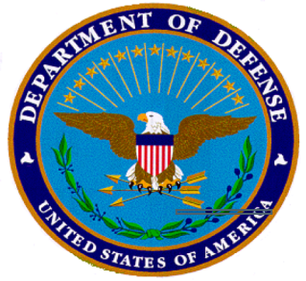



Federal Radon Action Plan
Federal leadership required to accelerate action on radon risk reduction
An example of Inter-Agency Collaboration
A special focus on families and low income communities
One of the most important Healthy Homes concerns
Notes:
EPA providing a call to action
FRAP is something that is owned and carried out by ALL agencies
This Plan is budget neutral – each agency must step up to the plate to implement commitments…and save lives

Slide 6
Overview of Progress
Nov 2010: Senior Leaders met and agreed to map out plan for unified federal action
Jun 2011: Launched the Federal Radon Action Plan at the Healthy Homes Conf
Feb 2012: Senior Leaders met to show continued commitment in protecting families from radon
Key Milestones:
Monthly Implementation Workgroup Meetings
Bi-Annual Senior Leadership Meetings
Notes:
On top off meetings, Office Director has meet individually with his counterparts to hold them to their commitments and see how we can help them in the process
Released the Action Plan Scorecard in January to show progress – transparency in this effort – not a plan that sits on the shelf
Despite budge cuts, senior leaders echoed, Gina and said they will continue to support the FRAP

Slide 7
Progress to Date

Slide 8
Framework for Federal Action
Demonstrate the importance, feasibility and value of radon testing and mitigation
Provide economic incentives to encourage those who have sufficient resources to test and mitigate, and provide direct support to reduce the risk for those who lack sufficient resources
Build demand for services from the professional, nationwide radon services industry
Notes:
Too few homes, schools and daycare facilities are tested for radon. An even smaller number are mitigated when high radon levels are found. Although the technical knowledge exists to reduce radon risks, the United States has not yet achieved the level of voluntary action required to make a real impact on indoor radon exposure.
Accordingly, there are three major and interrelated opportunities for changing the status quo, dramatically reducing radon exposure, and preventing thousands of lung cancer deaths annually:
• Demonstrate the importance, feasibility and value of radon testing and mitigation.
• Provide economic incentives to encourage those who have sufficient resources to test and mitigate, and provide direct support to reduce the risk for those who lack sufficient resources.
• Build demand for services from the professional, nationwide radon services industry.
By extending the reach, scope and impact of existing programs, the federal government can immediately reduce lung cancer risk for occupants in the homes, schools and daycare facilities the government owns, manages and administers; promote radon risk reduction in the homes, schools and daycare facilities its programs influence; and advance policies to help homeowners, buyers and builders address radon risk nationwide. Collectively, these actions have the potential to represent a measurable and comparatively cost-effective federal approach to improving public health and preventing cancer deaths.

Slide 9
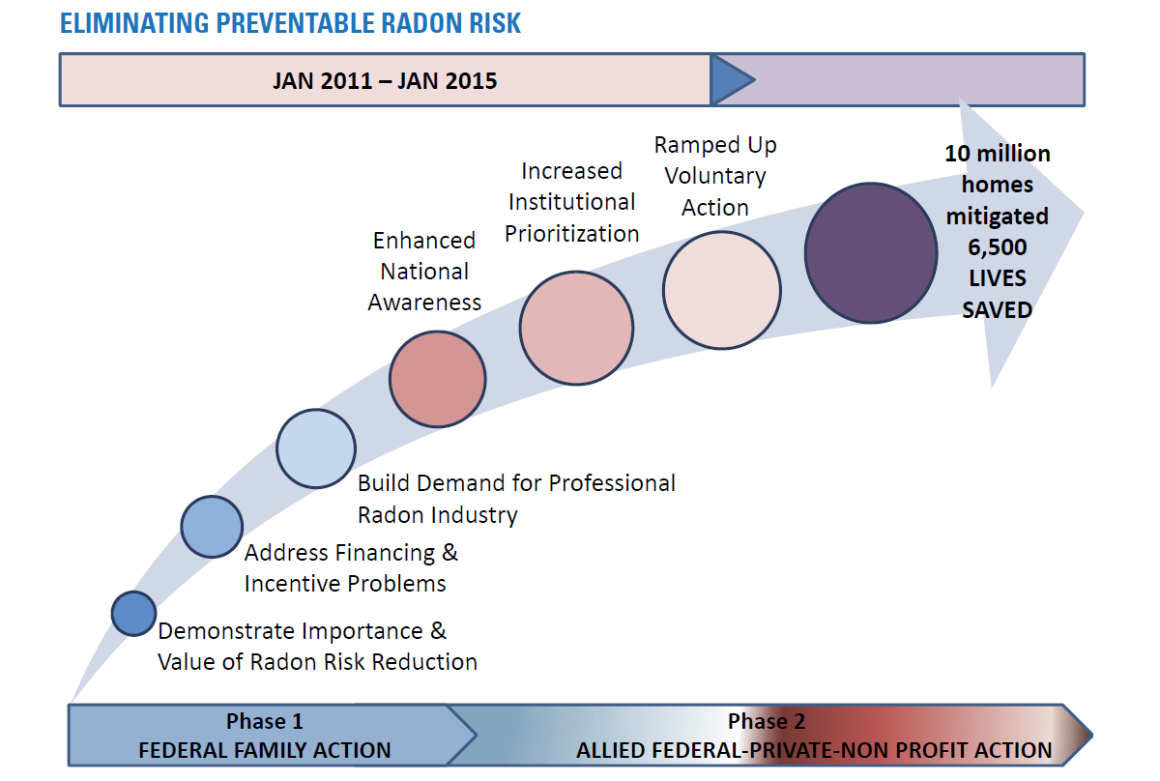
The Federal Family’s Power to Save Lives: Leadership, Leverage and Visibility
Notes:
The federal approach to radon takes advantage of the government’s unique ability to lead through demonstration, leverage programs across agencies to maximize their benefits, and use the broad visibility of government action to drive public understanding and focus public activity.

Slide 10
The Action Plan Scorecard
The scorecard = Commitment Status
  By Agency
  By Progress (Red/Yellow/Green)
  By Federal Radon Action Plan Framework
33 Total Commitments
http://epa.gov/radon/action_plan.html
Notes:
This scorecard shows the status on each commitment identified in the Action Plan and provides a target completion date. You can view progress in three different ways:
by agency,
by progress (green, yellow, or red circle), and
by the Action Plan Framework which groups actions by their primary intent to either demonstrate the importance of radon risk reduction, address finance and incentive issues to drive testing and mitigation or build demand for services from the professional nationwide industry.

Slide 11
Status of Commitments by Agency
Agency | Green – Completed | Yellow – On Track | Red – No Progress
USDA |  | 6
DoD |  | 1 | 2
DOE | 2 | 2
EPA |  | 2
GSA |  | 2
HHS |  | 3
HUD | 2 | 2
DOI | 1 | 2
VA |  | 1 | 1
Multi |  | 4
33 Total Commitments
Notes:
HUD approved inclusion of mitigation for high radon levels in Healthy Homes Production Program Grants

Slide 12
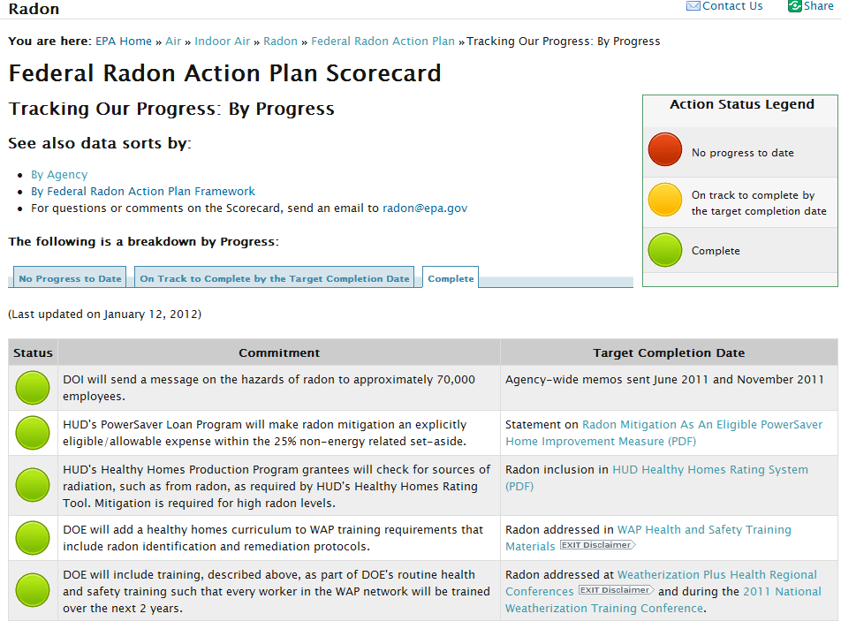
Notes:
Screen shot of the Scorecard by progress – all commitments that are completed.

Slide 13
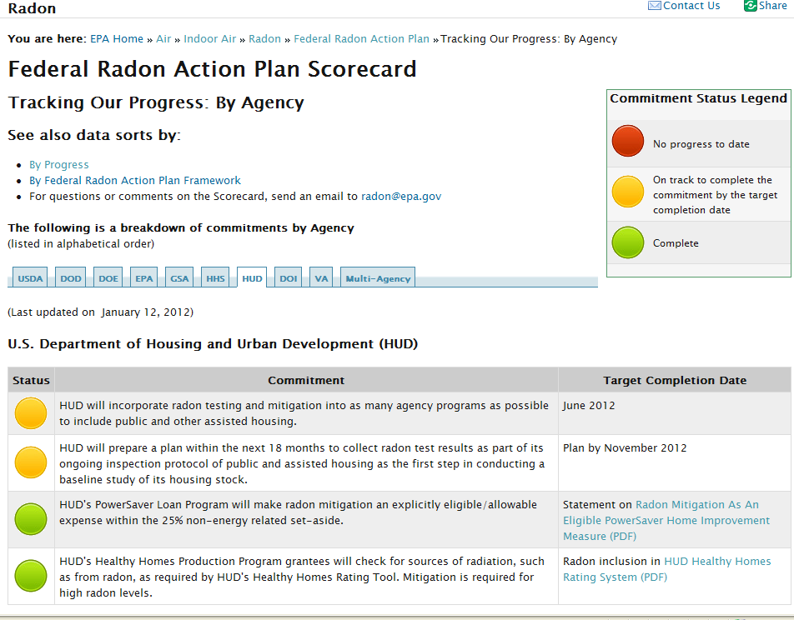
Notes:
Screen shot of Scorecard by agency – this shows the 4 commitments submitted by HUD – 2 completed and 2 still in progress.

Slide 14
HUD: Healthy Homes Production Program Grantees
Commitment:
  HUD’s Healthy Homes Production Program grantees will check for sources of radiation, such as from radon, as required by HUD’s Healthy Homes Rating Tool.
  Mitigation is required for high radon levels
Status: COMPLETED – Radon testing and mitigation (for high radon levels) included as a standard element in the Healthy Homes Rating Tool (http://portal.hud.gov/hudportal/documents/huddoc?id=operating_guidance_hhrs_v1.pdf)
Notes:
Highlighting some successes….
In order to be “green,” Agencies need to provide evidence that the commitment was actually completed – they need to provide some type of evidence - deliverable.
HUD has completed 2 of their 4 commitments.
HUD continues to show their support for this program by working with departments across their Agency to include and strengthen “radon” language where possible. Radon fits perfectly within HUD’s strategic goals and have strengthened the language within the Healthy Homes Rating Tool and included radon testing and mitigation where radon levels are high.

Slide 15
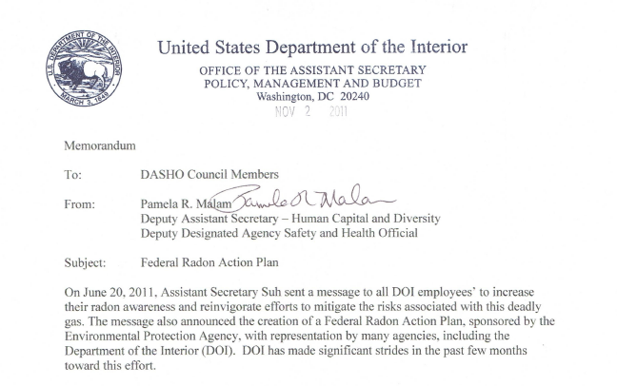
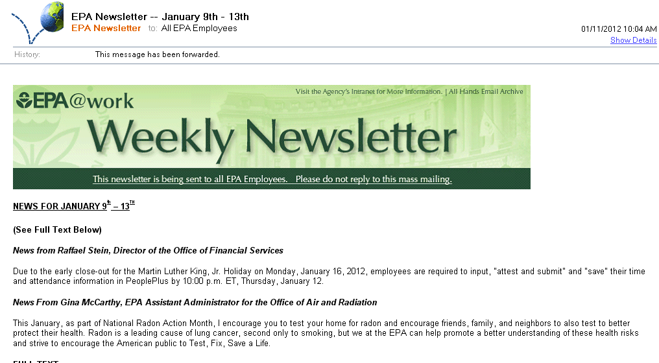
Multi-Agency Outreach
Commitment: Federal Agencies will send a message on the hazards of radon to all employees
Notes:
EPA followed DOI’s lead by sending a message to all their employees – noting that “safety begins at home” – in this case our own federal families.
Gina McCarthy sent a note to all EPA employees in January stating…This January, as part of National Radon Action Month, I encourage you to test your home for radon and encourage friends, family, and neighbors to also test to better protect their health. Radon is a leading cause of lung cancer, second only to smoking, but we at the EPA can help promote a better understanding of these health risks and strive to encourage the American public to Test, Fix, Save a Life.

Slide 16

DOI: Bureau of Indian Affairs
Commitment:
  Test approximately 3,500 residential units and 500 schools, and
  Work with Tribes to increase awareness of the radon risk.
Status: This initial effort initiates the pilot testing of one school and one housing unit (dormitory), in order to scope and guide the full testing effort.
Anticipated Outcome: Full Scale Testing SOW and RFP to be completed June 2012

Slide 17
Moving Forward

Slide 18
Summer 2012: 1-Year Anniversary Event
Intent:
Continue Senior Leadership Commitment
Recognize Accomplishments to Date
Identify New Partners and Commitments
Notes:
As I mentioned earlier, everyone’s budget has been cut. We’re leveraging all resources across the agencies to figure innovative ways to implement the commitments in the plan and surface new ideas
Ideas come from the ground up are usually more successful.
Potential project with DOL – Youthbuild – focus on 16-24 year olds – several tribal organizations receiving grant.
Please pressure feds at local levels and encourage their participation.

Slide 19
Indoor Environments Division
Healthier Buildings, Healthier People
General IAQ Issues:
    http://www.epa.gov/iaq/
Center for Radon and Air Toxics:
http://www.epa.gov/radon/
Peggy Bagnoli:
    Bagnoli.Peggy@epa.gov

Slide 20
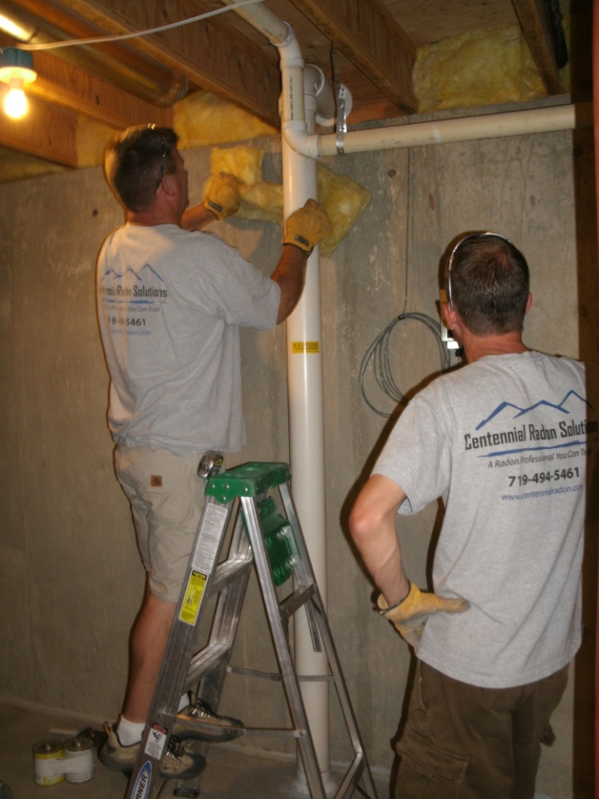
Do it yourself training

Slide 21
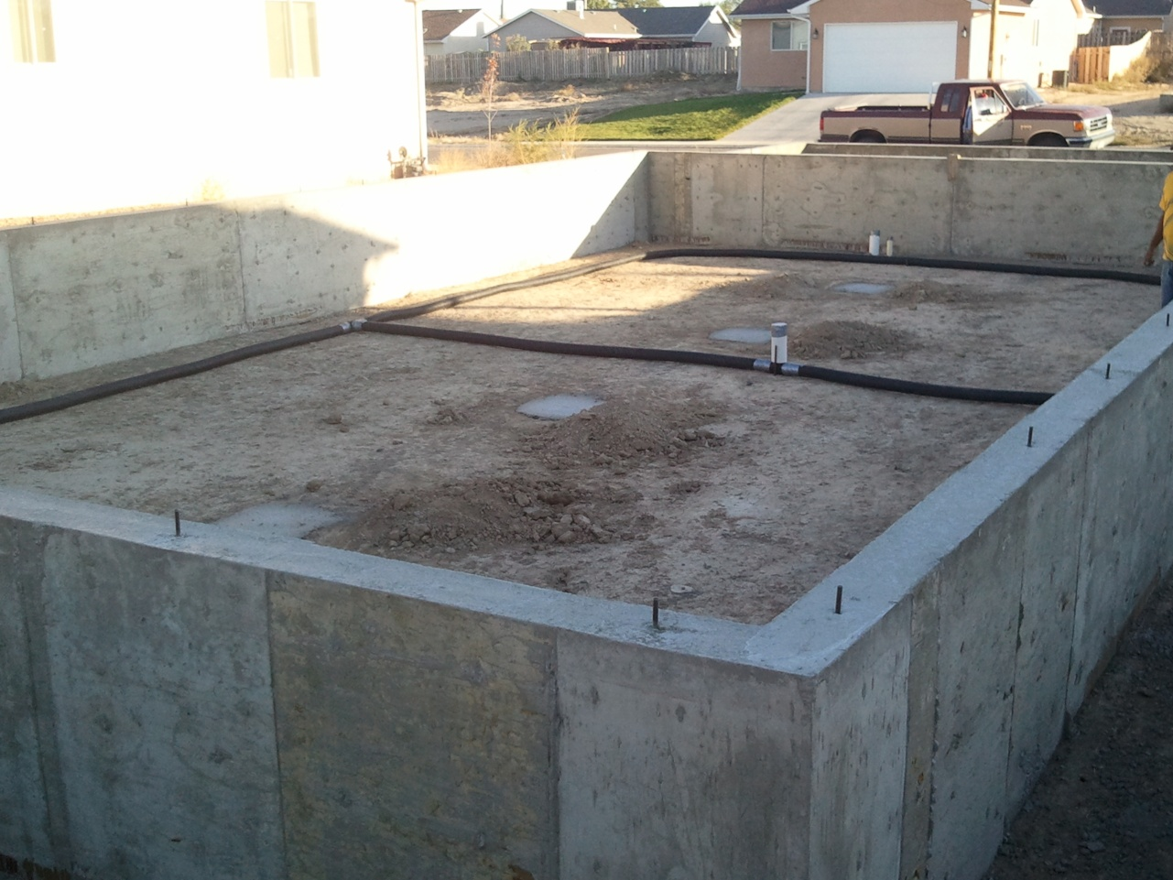
Habitat House – Pueblo, CO

Slide 22
Pueblo, CO: A Community in Action
3800 test kits distributed
1800 results reported
300 Mitigations performed
90 DIY (Homeowner w/ mitigator)

Slide 23
What else can we do?
Get better at sharing information and training
Work directly with low-income home owners
Interface with the DOE Weatherization processes
Adoption of local ordinances
Change law and regulation
Find willing partners (e.g. H4H)
What else?

