Slide 1
Healthy Homes &
Low-Income Housing
The Habitat for Humanity of Utah County
Radon Experience

Slide 2
The Mission of Habitat
Habitat for Humanity of Utah County is working to eliminate poverty housing and homelessness in in our service area by building and renovating simple, decent homes with low-income families in need of safe and affordable housing.

Slide 3
Habitat’s Commitment
To help keep our partner families healthy, Habitat for Humanity of Utah County has committed to use RRNC in all new construction and install mitigation systems in existing homes that are
renovated locally.

Slide 4
Thinking outside the box

Slide 5
The Partnership
Habitat for Humanity of Utah County
Utah County Health Department
Utah Department of Environmental Quality
Utah Cancer Action Network

Slide 6
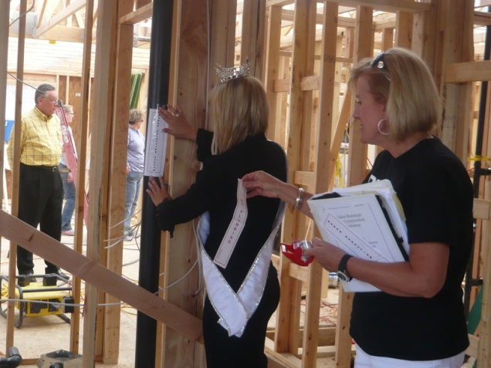
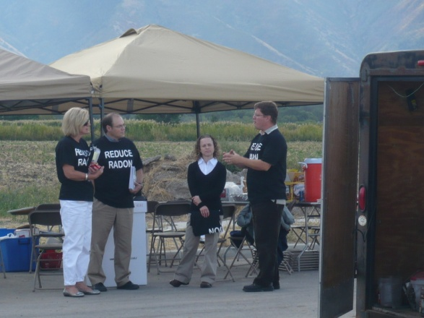
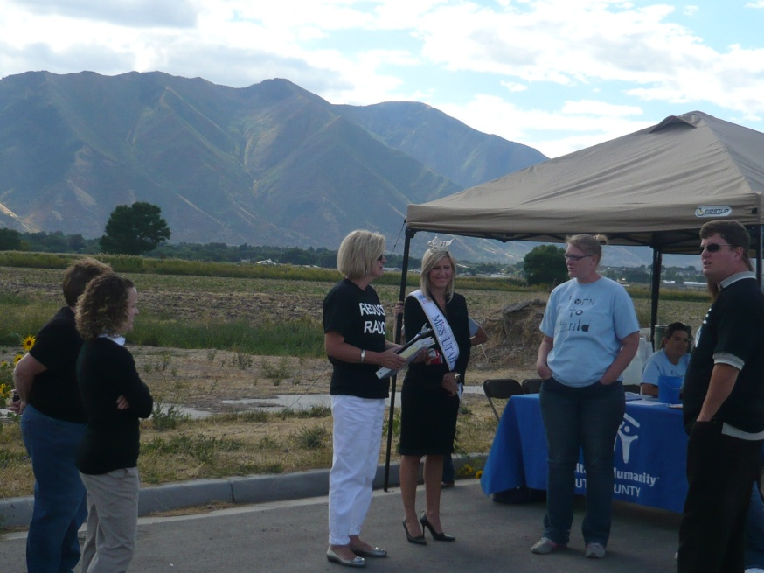
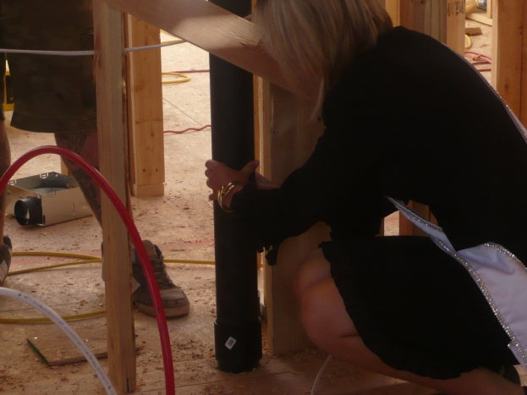
Partnership Kickoff

Slide 7
Partnership Goals
Reduce Utahns’ risk related to environmental carcinogens.
Increase Utahns’ knowledge of radon risks.
Encourage radon resistant construction.
Increase radon testing and mitigation.
Increase public awareness of the radon problem and of the relationship between indoor radon and lung cancer.

Slide 8
Strategies
Provide free continuing education core credit course for builders, inspectors, and Realtors.
Educate elementary students about the relationship between indoor radon and lung cancer. Encourage students to participate in the National Radon Poster Contest.
Build new Habitat homes radon resistant and mitigate renovation homes.
Promote radon awareness and testing during the National Radon Action Month in January.
Distribute radon test kits through the Habitat for Humanity ReStore.
Promote RRNC to home builders and home buyers during the Utah Valley Parade of Homes.

Slide 9
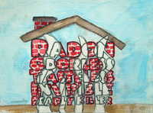
Successes
Two Habitat staff members have attended the NEHA's RRNC Workshop in Washington D.C.
18 individuals attended RRNC training for builders.
13 individuals attended the RRNC training for Coldwell Banker Realtors.
Over 900 elementary students have received radon education.
85 students have participated in the National Radon Poster Contest. In 2010, two posters submitted from Utah County won 2nd and 3rd for the state of Utah.

Slide 10
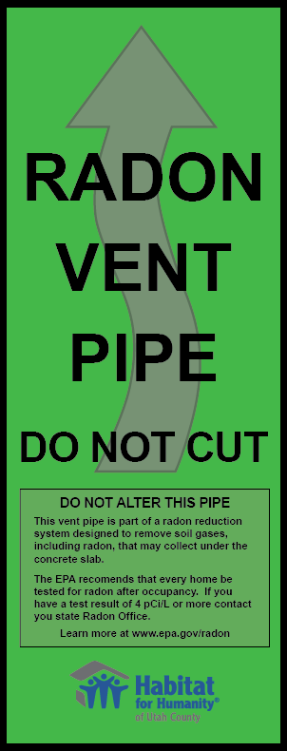
Successes
Habitat for Humanity of Utah County has built six new homes radon resistant and has also mitigated two renovation homes.
$300-$2,400 per home

Slide 11
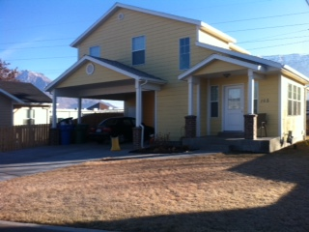
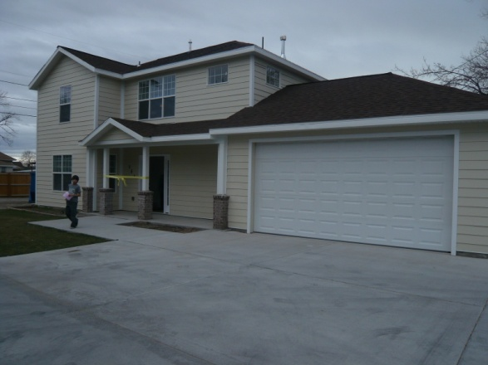
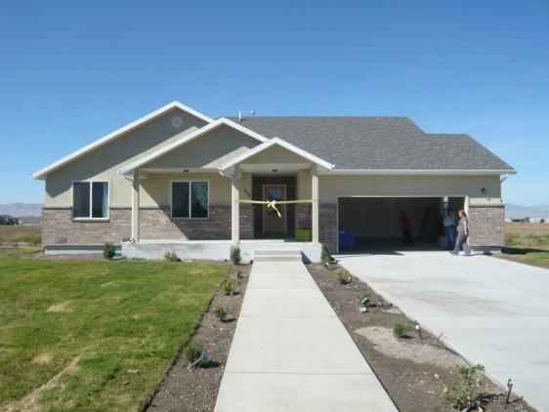
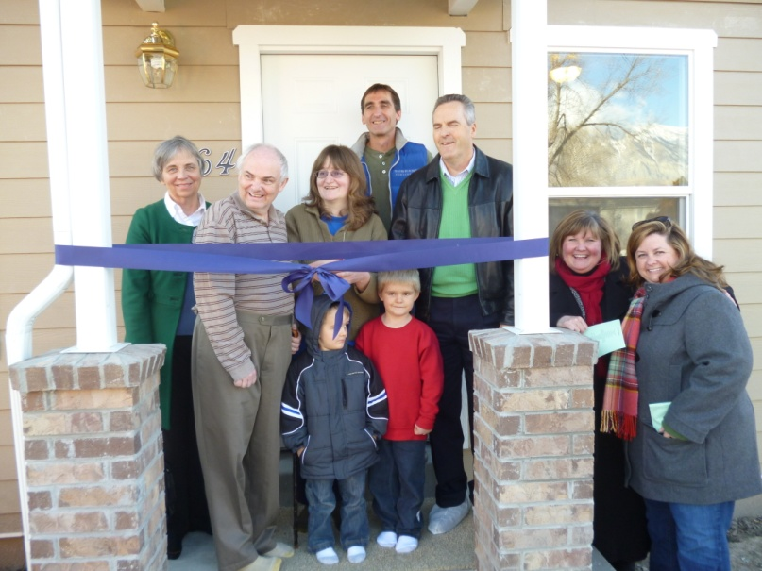
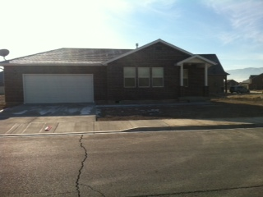
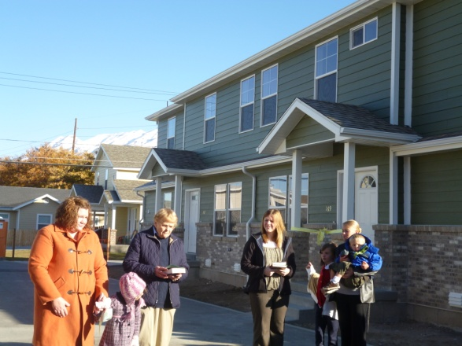
Habitat Radon Resistant & Mitigated Homes

Slide 12
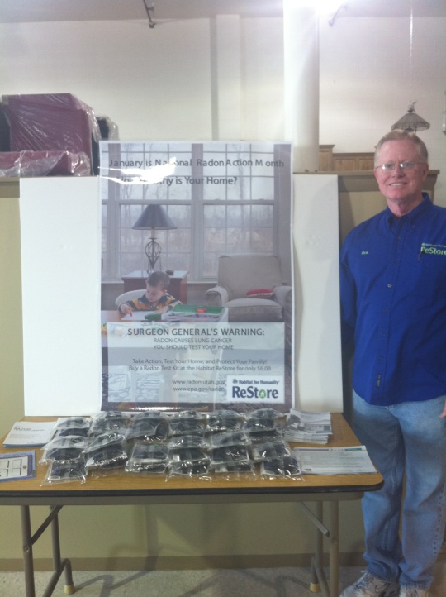
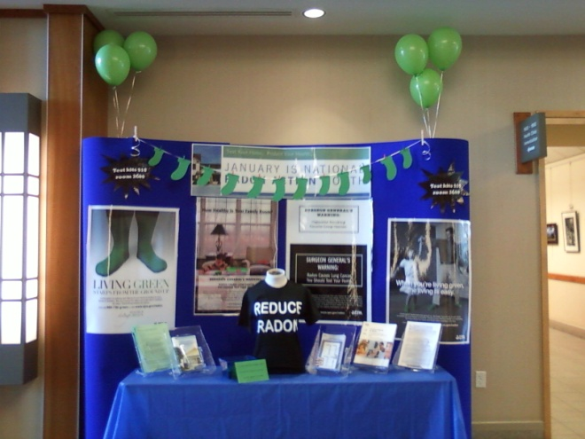
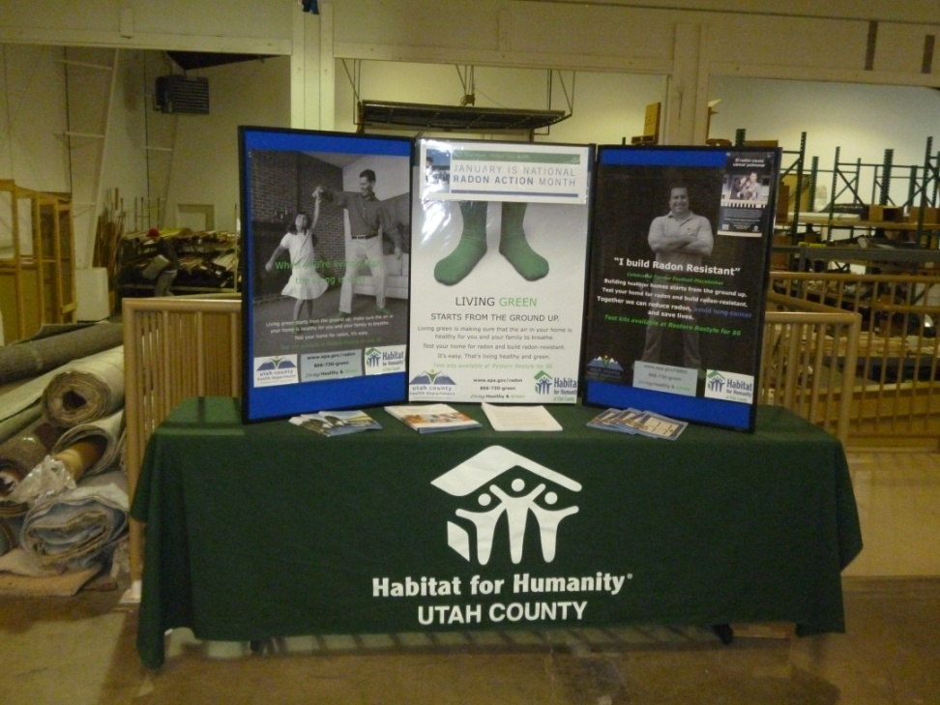
Successes
Habitat for Humanity of Utah County and the Utah County Health Department have participated in January’s National Radon Action Month for the past two years promoting radon awareness and testing to hundreds of community residents .

Slide 13
Successes
Habitat for Humanity of Utah County has sold over 400 radon test kits in the last two years.
  Air Chek, Inc. (company who analyzes the tests) has provided test results for close to half the kits that have been sold. Two-thirds of the tests have exceeded 4piC/L.
  Postcards are sent to community members with high radon test results encouraging them to re-test and seek mitigation.
  Postcards are also sent to remind community members who have purchased test kits to test their homes.

Slide 14
Surprises!
Habitat received an invitation to present at this conference.
Increased media coverage.
RadonAway donated a fan for the blitz build home in Springville.
Noticeable increase in new ReStore customers.
EPA Grant to provide Training for Radon Measurement and Mitigation Certification.
Amazing partnerships.

Slide 15
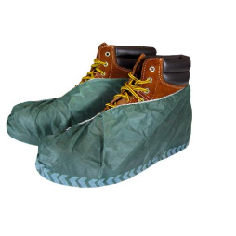
Next Steps
Promote radon awareness and testing.
Increased sales and encouraged use of radon test kits.
Utah Valley Parade Homes promotion.

Slide 16
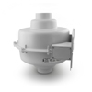
Next Steps
Continue Habitat’s RRNC and mitigation efforts.
Finding additional funding to add fans to our systems.
Encourage other Habitat affiliates to participate in RRNC and mitigation.

Slide 17
Questions & Answers

Slide 18
Kena Jo Mathews
Executive Director
Habitat for Humanity of Utah County
340 South Orem Blvd.
Orem, UT 84058
(801) 344-8527
kena@habitatuc.org

