Slide 1
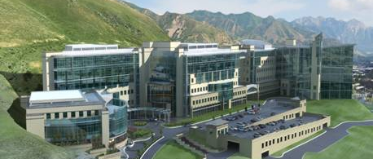
Radon from a Physician’s Perspective Non-Tobacco related Lung Cancer Deaths in Utah
Wallace Akerley MD
Huntsman Cancer Institute
@ University of Utah
April 12, 2012

Slide 2
Lung Cancer
New Cases: 226,160
Deaths: 160,340
Leading cause of cancer-related
mortality in the United States
  - More then breast, prostate, colon,
  and pancreas combined
5-year relative survival rate 15.7%
American Cancer Society: Cancer Facts and Figures 2012

Slide 3


Invisible Ribbon
Lung Cancer – Unrecognized
Invisible Killer
Number 1 Cancer Mortality in the USA
Lacks Advocacy
Guilt
Stigma
A L C A S E
Notes:
Blue Prostate
Red AIDS
Pink Breast
Ovarian Teal

Slide 4
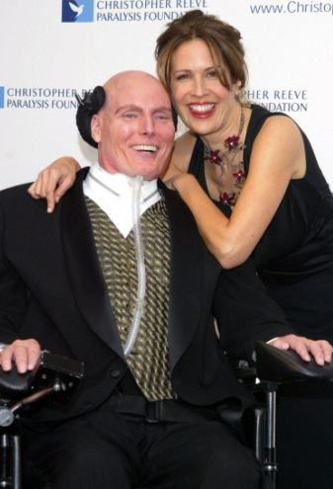


Lung Cancer
Smoking
Non-Smoking
Notes:
Journalist Peter Jennings
Dana Reeve

Slide 5

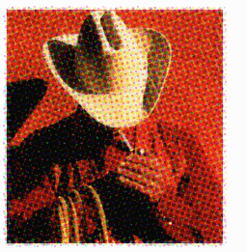
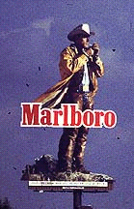

Slide 6
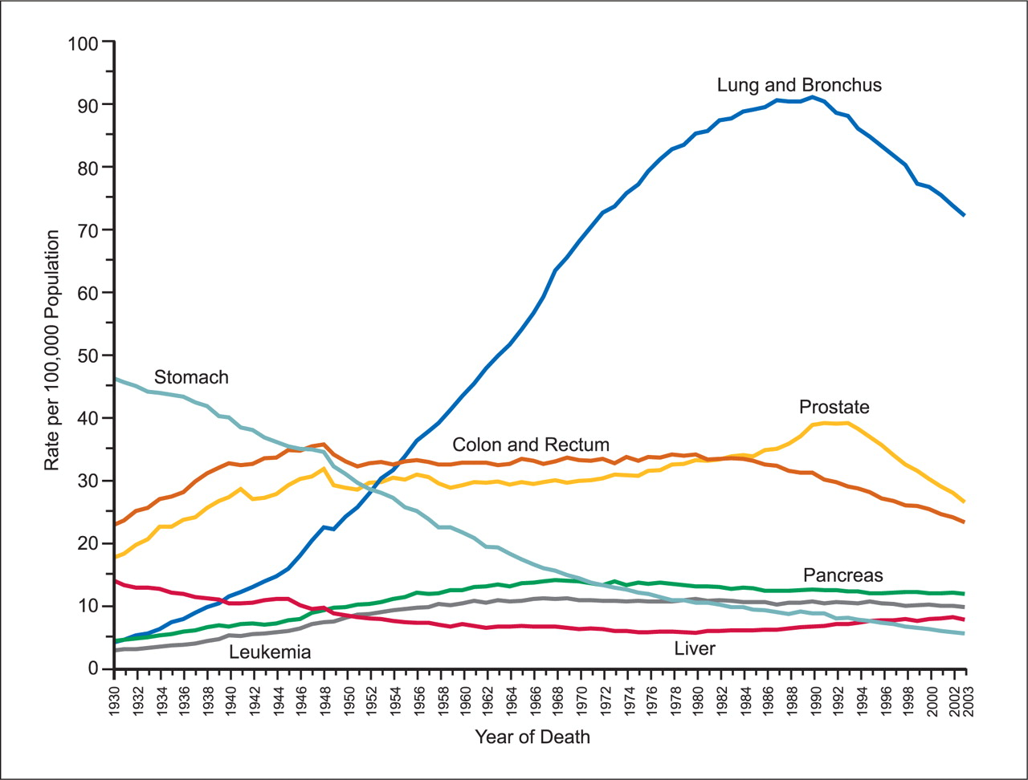
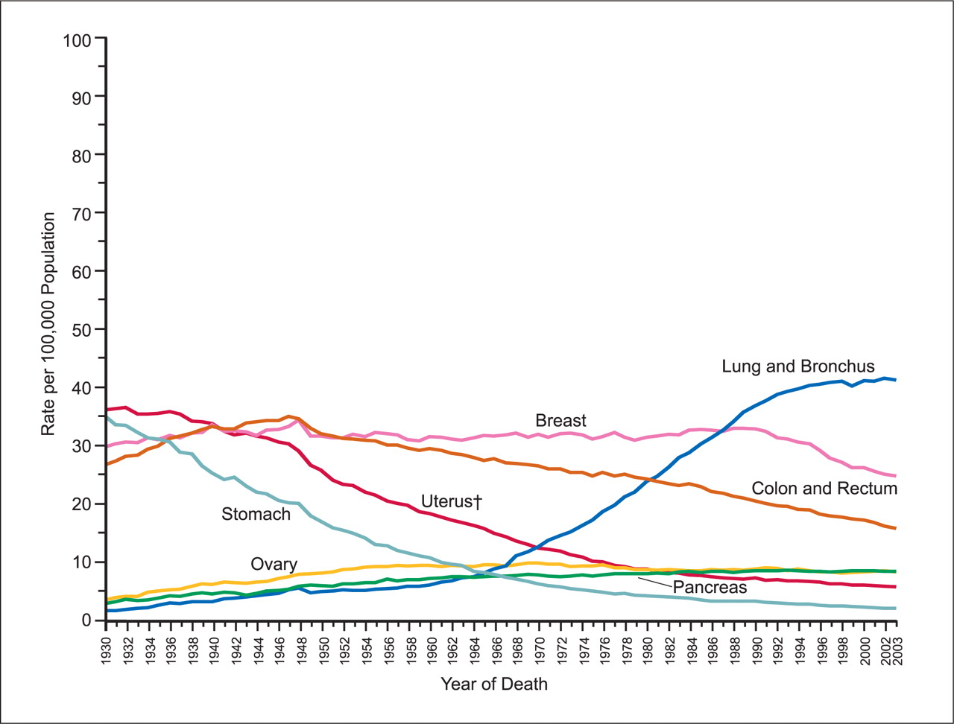
Age-adjusted Cancer Mortality
USA: 1930-2007 by Gender
Male
Female
All Cancer Mortality 41%, Lung Cancer Mortality 15%

Slide 7
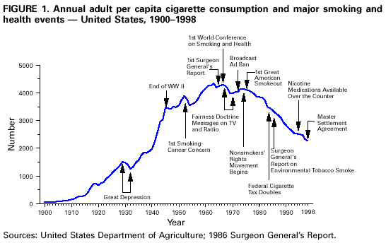

Slide 8
Histogram of States and
Percent Smokers 2001
USA
22.7%
UT
13.2%
Utah 2007: 11.7%
CDC Website

Slide 9
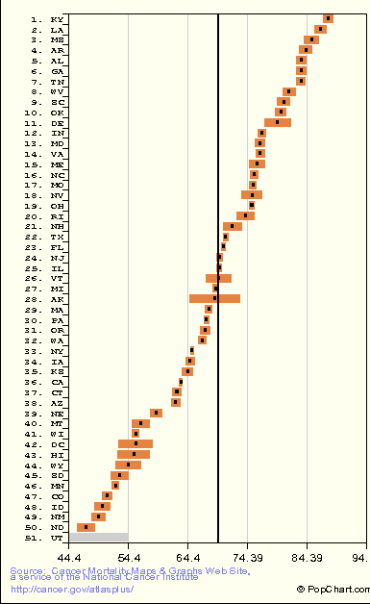
Lung Cancer Incidence by State
Http//cancer.gov/atlasplus, 2002

Slide 10
Utah Cancer Mortality
400
300
200
200
CA Cancer J Clin 2012;62:10-29

Slide 11
Causes of Lung Cancer
Smoking 85-90%
Radon 10-15%
Other pollutants 1-2%
Lung Cancer Deaths due to Radon =
15,000 - 20,000 deaths per year
Alberg et al. Chest 132:29s, 2007

Slide 12
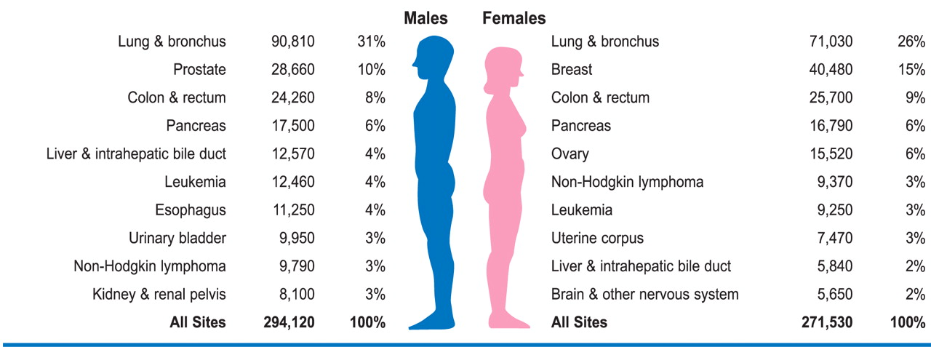
USA 2009:
Estimated Cancer Deaths by Gender
Radon-related lung cancer > Esophageal, bladder, lymphoma,
kidney, uterine, liver, brain, leukemia
CA Cancer Clin J 58:71, 2008

Slide 13
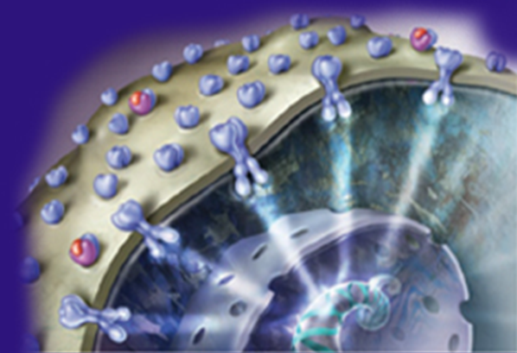
Unique Features of Non-Tobacco related lung cancer
Clinical
  Female, younger, adenocarcinoma, spread
Genetic DNA
  EGFR Mutation - erlotinib
    Female, adenocarcinoma, Asian
    60% of non-smokers
  ALK Mutation - crizotinib
    25% of non-smokers

Slide 14
Radon
January 13, 2005, Dr. Richard H. Carmona, the U.S. Surgeon General, issued a national health advisory on radon.
Radon affects smokers and not-smokers

Slide 15
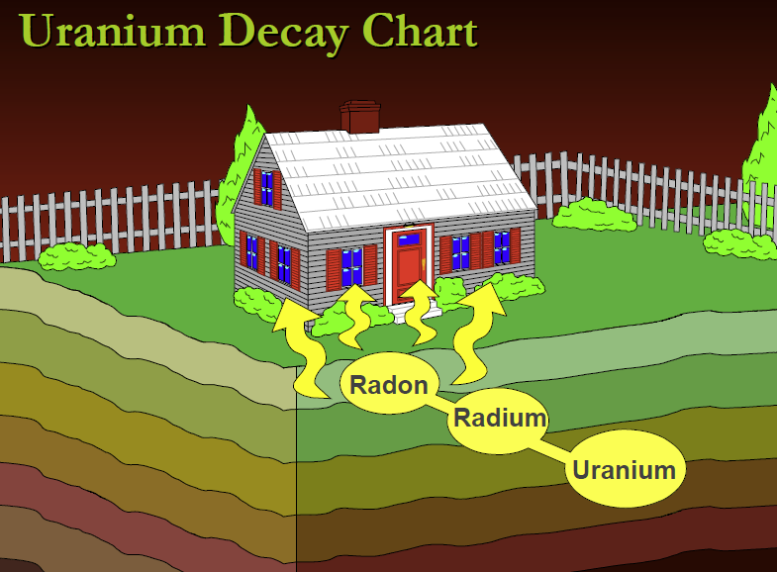
Radon
Ubiquitous, natural occurring radioactive gas that you can’t see, smell or taste.

Slide 16
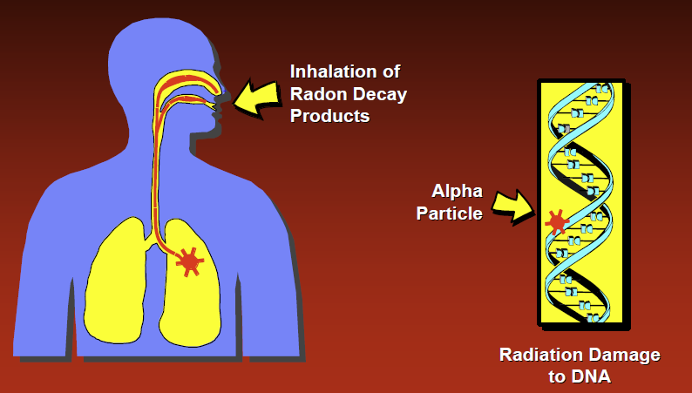
Radon Effects

Slide 17
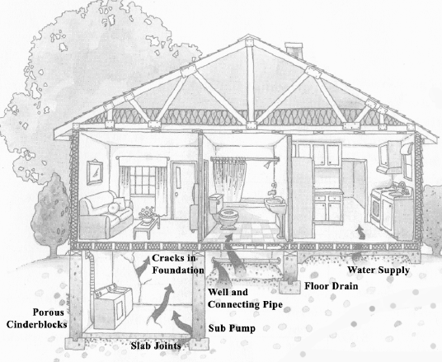
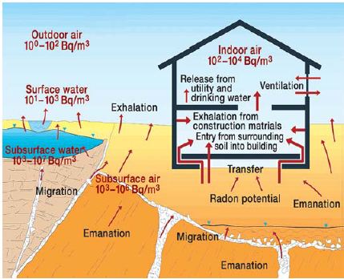
Radon Paths

Slide 18
Units of Radon
Outdoors = 0.4 pCi/L
Average house = 1.3 pCi/L
4 pCi/L increases lung cancer by 50%

Slide 19
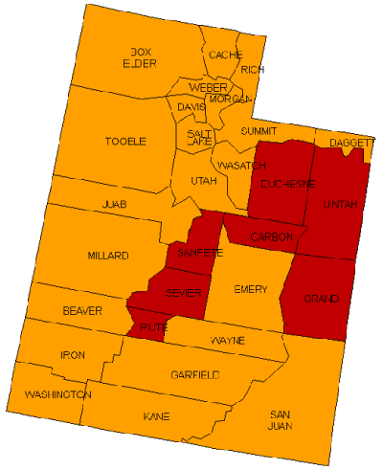
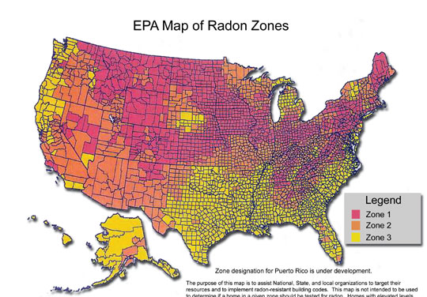
Geographic Variation (1)
Zone 1 >4 pCi/L
Zone 2 2-4 pCi/L
Zone 3 <4 pCi/L
epa.gov/iaq/radon/2003

Slide 20
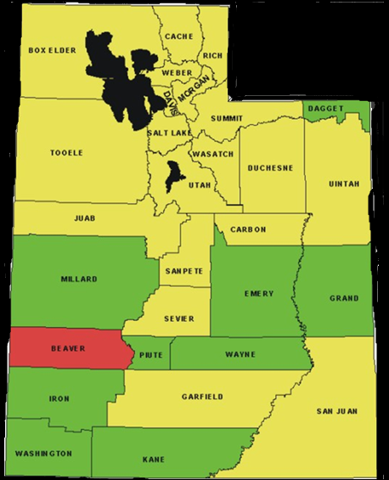

Geographic Variation (2)
Zone 1 >4 pCi/L
Zone 2 2-4 pCi/L
Zone 3 <4 pCi/L
www.utah.gov, 2011

Slide 21
Worst Rooms in the House
Basements
Ventilation
Time spent (Bedrooms)
  Age of subject

Slide 22
Seasonal Variation
Radon is affected by Weather
  Closed Windows
  Wind
January is Radon Awareness Month
Inversion???

Slide 23
Radon Safety
No level of radon is safe
EPA says fix for >4pCi/l
2-4 fixed should be considered
Winter is good time to check for Radon

Slide 24
Radon and Lung Cancer Risk for
Non-smoker
pCi/l Deaths* Reference
1.3 2 Risk of dying in a house fire
2 4 Risk of dying from Poison
4 7 Dying in a car crash
8 15
10 18
20 36
Smoker
20
32
62
120
250
360
*Risk per 1000 lifetime, Synergy for smokers=8X
1.3 pCI/l = average household, 0.4 pCi/l=outdoors

Slide 25
Utah Radon Questionnaire
11/09, 497 queried, 12 .5% tested
Have you heard of radon? 100%
  natural radioactive gas? 57.8%
  Detection requires a test? 73.7%
  Causes lung cancer? 38.3%
  Can be fixed? 82.8%
  4 questions correct 20%
EPA: Test before purchase and repeat
Utahans, Children, Renters at risk
Utah Health Annual Review 2012

Slide 26

What can you do about it?

Slide 27
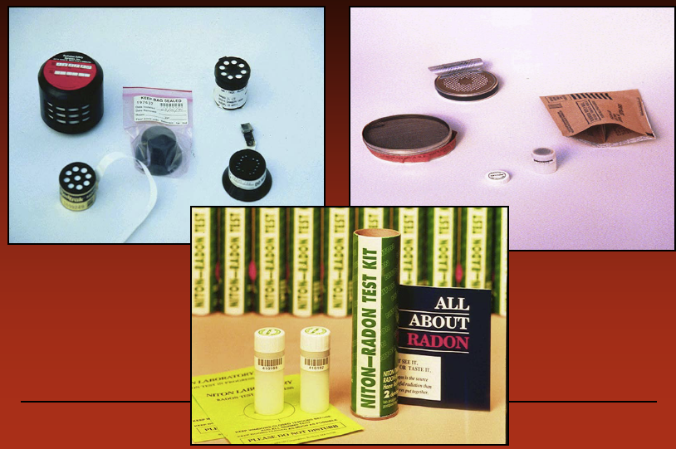
Radon Test Kits

Slide 28
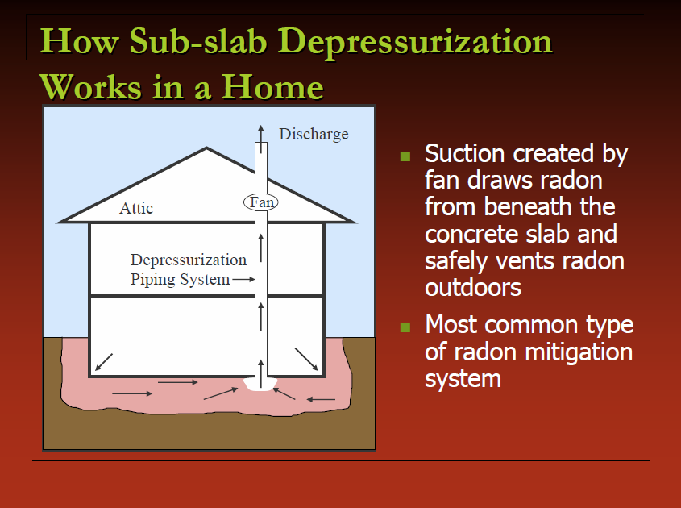
Mitigation

Slide 29
Summary
Radon is a natural radioactive gas that you can’t see, smell or taste.
Radon is the leading cause of lung cancer after cigarettes and it can be prevented
Non-tobacco related lung cancer is a unique entity and a substantial public health issue
Radon Awareness Deficit
Homes, public buildings should be tested

